Slide 1
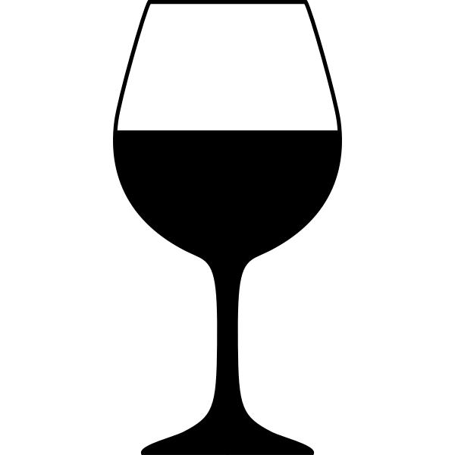
Predicting Wine Quality Using Machine Learning Algorithms
Bijan Emadi
Spring ‘22

Slide 2
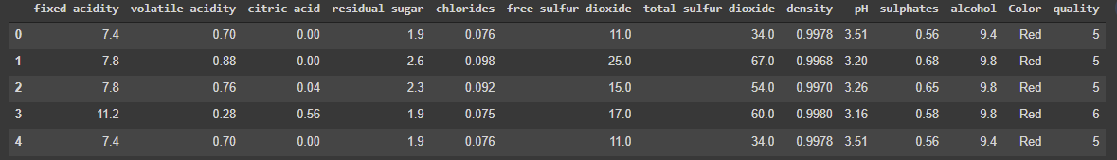
The Data
Originally two separate datasets.
Very clean, no missing or duplicate values.
Objective data likely measured in concentration (g/L)

Slide 3
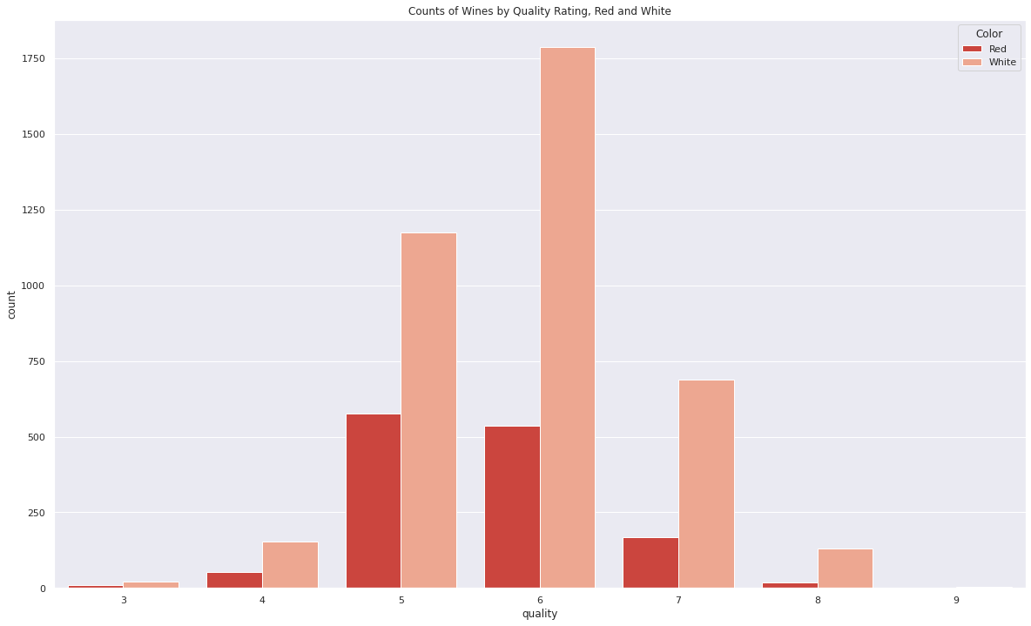
Visuals

Slide 4
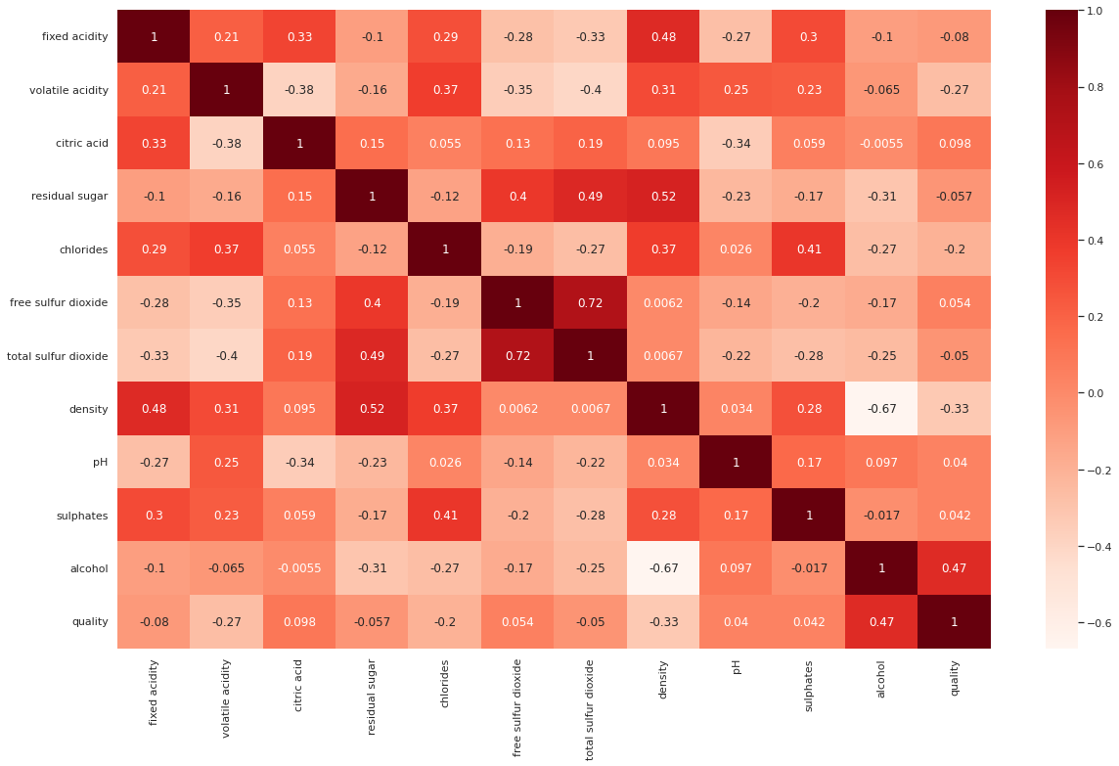
Correlation

Slide 5
52%
KNN Model Testing Accuracy

Slide 6
58%
Random Forest Classifier Testing Accuracy

Slide 7
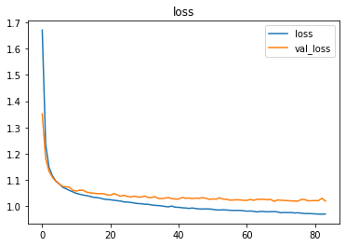
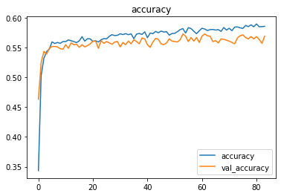
The Models - Deep Learning Neural Network

Slide 8
Discussion and Future Work
Improving this model will require a more balanced dataset
More features, possibly beyond the physicochemical, may need to be considered.
Finally, there is no such thing as ‘true quality’.

Slide 9
Conclusion - Our model has its limits, but can be improved with better data. The best way to judge a wine is to taste it yourself! ;D

